Slide 1
R. Balaji B-tech (Electrical and Electronic Engineering)
SMVEC(Pondicherry) Data Analytics Insurance Claims Project
Great learning

Slide 2
Star format
SITUATION : TO PRIDICT THE FUTURE BY DOING DATA ANALYSIS AND TO TAKE BUSINESS DECISIONS.
AN INSURANCE FIRM WANTS TO INCREASE PROFIT BY SELLING MORE PREMIMUMS AND REDUCE CUSTOMER CLAIMS.
TASK: HERE WE SHOULD UNDERSTAND THE KEY CUSTOMER ATTRIBUTES OR FEATURES TO DETERMINE THE POTENTIAL CUSTOMERS WHO WILL BUY MORE PREMIUMS AND CLAIM LESS.
ACTION: WE HAVE INFORMATION ABOUT KEY CUSTOMER FEATURES SUCH AS AGE SEX, BMI ETC.ALSO WE HAVE INSURANCE AMOUNT CLAIMED BY THE CUSTOMERS.
RESULTS:WE HAVE ANALYZED THAT SMOKER ,AGE,BMI,CHILDREN ARE THE SIGNIFICANT VARIBLES TO PREFORM A PERFECT REGRESSION MODEL,SO OTHER VARIBLES LIKE SEX,CHARGES ETC ARE THE INSIGFICANT VARIBLES,HAVE P VALUE GREATER THAN 0.05.
SO WHAT I CAN CONCLUDE IS THE CHARGES OF THE INSURANCE WILL BE VARIED ACCORDINGLY TO THE VARIBLES LIKE SMOKER,AGE,BMI,CHILDREN.

Slide 3
1.Exploratory Data Analysis Region vs count of BMI

Slide 4
Region vs count of BMI
Row Labels | Count of bmi
northeast | 324
northwest | 325
southeast | 364
southwest | 325
Grand Total | 1338

Slide 5
REGION VS COUNT OF AGE

Slide 6
REGION VS COUNT OF AGE
Row Labels | Count of age
northeast | 324
northwest | 325
southeast | 364
southwest | 325
Grand Total | 1338

Slide 7
REGION VS COUNT OF AGE

Slide 8
REGION VS COUNT OF AGE
Row Labels | Count of sex
northeast | 324
northwest | 325
southeast | 364
southwest | 325
Grand Total | 1338

Slide 9
SUMMARY STATITICS OF AGE

Slide 10
SUMMARY STATITICS OF AGE
Mean | 30.66339686
Standard Error | 0.166714232
Median | 30.4
Mode | 32.3
Standard Deviation | 6.098186912
Sample Variance | 37.18788361
Kurtosis | -0.050731531
Skewness | 0.284047111
Range | 37.17
Minimum | 15.96
Maximum | 53.13
Sum | 41027.625
Count | 1338

Slide 11
SUMMARY STATITICS OF BMI
Mean | 1.094917788
Standard Error | 0.032956155
Median | 1
Mode | 0
Standard Deviation | 1.20549274
Sample Variance | 1.453212746
Kurtosis | 0.202454147
Skewness | 0.93838044
Range | 5
Minimum | 0
Maximum | 5
Sum | 1465
Count | 1338

Slide 12
SUMMARY STATITICS OF CHARGES
Mean | 13270.42227
Standard Error | 331.0674543
Median | 9382.033
Mode | 1639.5631
Standard Deviation | 12110.01124
Sample Variance | 146652372.2
Kurtosis | 1.606298653
Skewness | 1.515879658
Range | 62648.55411
Minimum | 1121.8739
Maximum | 63770.42801
Sum | 17755824.99
Count | 1338

Slide 13
AGE:
SKEWNESS IS POSITIVE SO THE TAIL BEND TOWARDS RIGHTSIDE SO IT MEAN THAT LOW NUMBER OF DATA IS SPREAD OVER THE RIGHT SIDE . KURTOSIS IS NEGATIVE INDICATE SPREAD OF DATA IS FLAT AND HAS THIN TALES MINIMUM AGE IS 18 AND MAXIMUM AGE IS 64
BMI:
SKEWNESS IS POSITIVE THE TAIL OF SPREAD OF DATA CURVE IS LONGER ON THE RIGHT SIDE. KURTOSIS IS NEGATIVE INDICATE THAT DISTRIBUTION IS FLAT AND HAS THIN TAILS MAXIMUM BMI IS 53 AND MINIMUM BMI IS 15
CHARGE:
SKEWNESS IS POSITIVE INDICATE THAT TAIL OF SPREAD OF DATA IS MORE ON THE RIGHT SIDE.
KURTOSIS IS POSITIVE INDICATES THAT DISTRIBUTION IS PEAKED AND POSSES THICK TAILS. MAXIMUM CHARGE IS 63770 AND MINIMUM CHARGE IS 1121
CHILDREN:
SKEWNESS IS POSITIVE SHOWS THAT MORE NUMBER OF DATA IS CLUSTERED AND SPREAD IN THE RIGHT SIDE. KURTOSIS IS POSITIVE INDICATES THAT SPREAD OF DATA IS IN PEAK AND HAS THICK TAILS. MAXIMUM CHARGE IS 5 AND MINIMUM CHARGE IS 0

Slide 14
2.Identify the categorical and continuous variables
Continous | Catogorical
Age | sex
BMI | region
Charges | Smoker

Slide 15
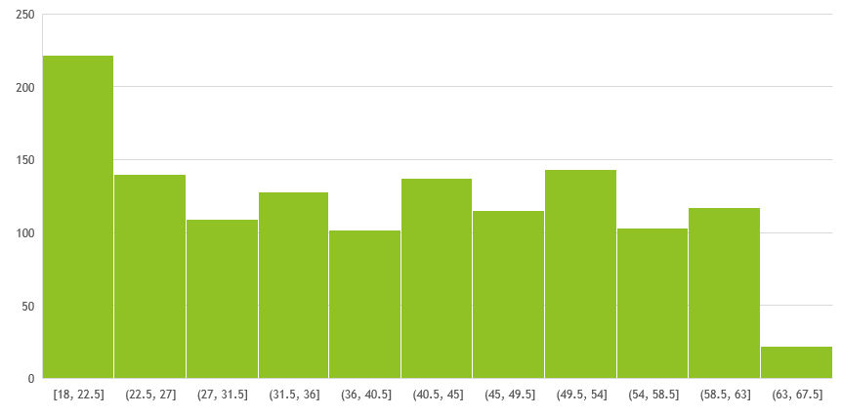
3.Make Histograms and box plots for continuous variables, do a correlation analysis. 1.Histogram and box plot of age

Slide 16
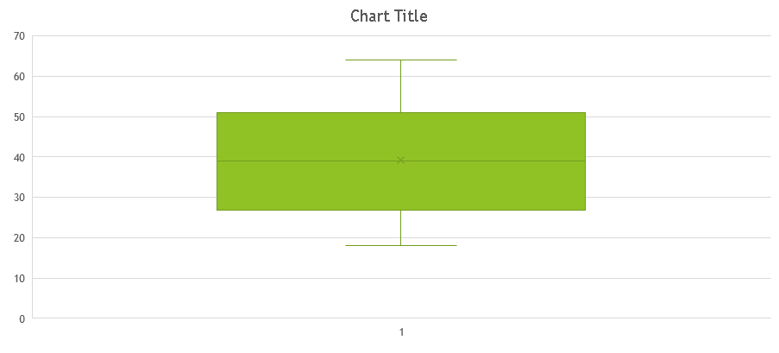
Box plot

Slide 17
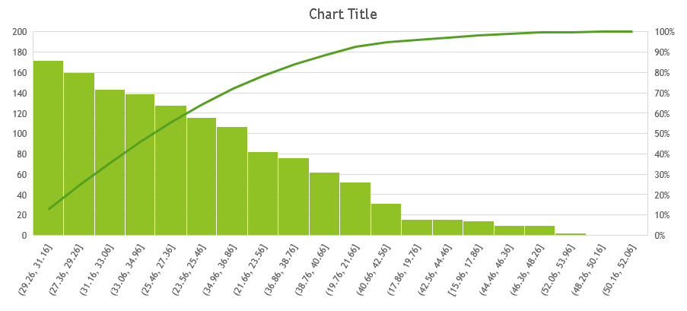
2.HISTOGRAM AND BOX PLOT OF BMI

Slide 18
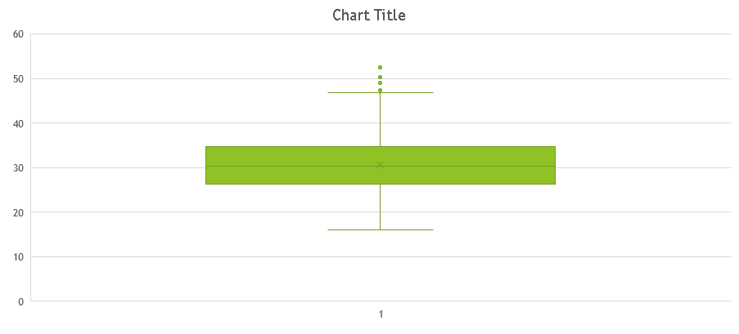
BOX PLOT

Slide 19
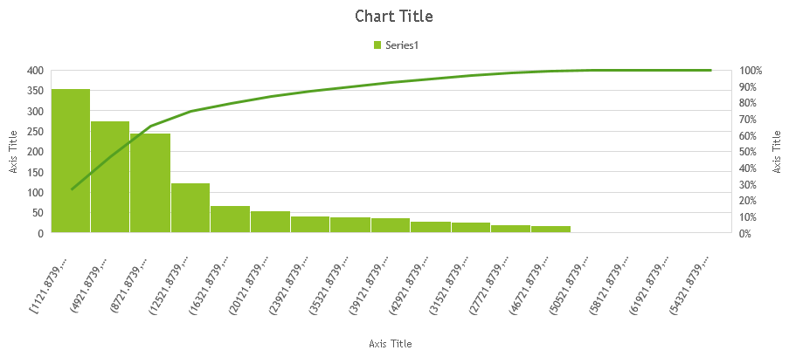
3.HISTOGRAM AND BOX PLOT OF CHARGES

Slide 20
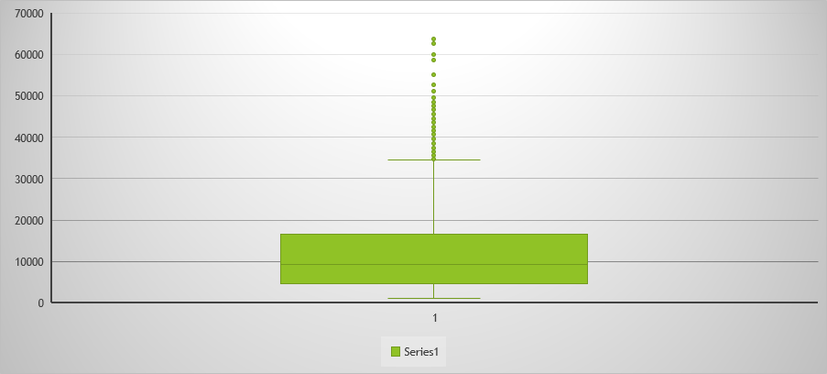
BOX PLOT

Slide 21
4.Make relevant Pivot tables and charts for : 1) Male/Female ratio and which gender has more smokers 2) Charges vs Age 3) Charges vs BMI 4) Charges for Smokers vs Non-smokers
COUNT OF SMOKER | COLUMN LABELS
ROW LABELS | FEMALE | MALE | GRAND TOTAL
NO | 547 | 517 | 1064
YES | 115 | 159 | 274
GRAND TOTAL | 662 | 676 | 1338
1 st question
1.Male Smoke more than Female
2.In Total of 1338 1068 is not smoking and 274 is smoking

Slide 22
4 th question 2,3,4 graph representation

Slide 23
5.Region-wise Smokers vs non-smokers analysis with one or more pivot table and charts
For non Smokers
smoker | no
Row Labels | Count of smoker
northeast | 257
northwest | 267
southeast | 273
southwest | 267
Grand Total | 1064

Slide 24
For smokers
smoker | yes
Row Labels | Count of smoker
northeast | 67
northwest | 58
southeast | 91
southwest | 58
Grand Total | 274

Slide 25
6.Region-wise charges for smokers vs non-smokers
NON SMOKERS
smoker | no
Row Labels | Average of charges($)
northeast | 9165.531672
northwest | 8556.463715
southeast | 8032.216309
southwest | 8019.284513
Grand Total | 8434.268298

Slide 26
SMOKERS
smoker | yes
Row Labels | Average of charges($)
northeast | 29673.53647
northwest | 30192.00318
southeast | 34844.99682
southwest | 32269.06349
Grand Total | 32050.23183

Slide 27
7. Has charges got something to do with no. of dependants ?

Slide 28
8.Do a similar dependants-charges analysis, Region-wise
Row Labels | Average of children | Sum of charges($)
northeast | 1.046296296 | 4343668.583
0 | 0 | 1709090.011
1 | 1 | 1255885.893
2 | 2 | 694372.7888
3 | 3 | 561986.6186
4 | 4 | 101396.3518
5 | 5 | 20936.92045
northwest | 1.147692308 | 4035711.997
0 | 0 | 1494816.961
1 | 1 | 757038.9669
2 | 2 | 888644.7694
3 | 3 | 818163.3909
4 | 4 | 68082.11235
5 | 5 | 8965.79575
southeast | 1.049450549 | 5363689.763
0 | 0 | 2246649.335
1 | 1 | 1300268.987
2 | 2 | 1038079.061
3 | 3 | 645744.6105
4 | 4 | 72255.11986
5 | 5 | 60692.64925
southwest | 1.141538462 | 4012754.648
0 | 0 | 1647513.688
1 | 1 | 811705.8264
2 | 2 | 996558.6769
3 | 3 | 384890.3636
4 | 4 | 104532.8237
5 | 5 | 67553.269
Grand Total | 1.094917788 | 17755824.99

Slide 29
9.SUMMARY STATITICS OF 0 AND 1OF MODIFIED DATA TO DO REGRESSION
age |  |  | smoker 2 |  |  | bmi |  |  | children
Mean | 39.20703 |  | Mean | 0.204783 |  | Mean | 30.6634 |  | Mean | 1.094918
Standard Error | 0.384102 |  | Standard Error | 0.011036 |  | Standard Error | 0.166714 |  | Standard Error | 0.032956
Median | 39 |  | Median | 0 |  | Median | 30.4 |  | Median | 1
Mode | 18 |  | Mode | 0 |  | Mode | 32.3 |  | Mode | 0
Standard Deviation | 14.04996 |  | Standard Deviation | 0.403694 |  | Standard Deviation | 6.098187 |  | Standard Deviation | 1.205493
Sample Variance | 197.4014 |  | Sample Variance | 0.162969 |  | Sample Variance | 37.18788 |  | Sample Variance | 1.453213
Kurtosis | -1.24509 |  | Kurtosis | 0.145756 |  | Kurtosis | -0.05073 |  | Kurtosis | 0.202454
Skewness | 0.055673 |  | Skewness | 1.464766 |  | Skewness | 0.284047 |  | Skewness | 0.93838
Range | 46 |  | Range | 1 |  | Range | 37.17 |  | Range | 5
Minimum | 18 |  | Minimum | 0 |  | Minimum | 15.96 |  | Minimum | 0
Maximum | 64 |  | Maximum | 1 |  | Maximum | 53.13 |  | Maximum | 5
Sum | 52459 |  | Sum | 274 |  | Sum | 41027.62 |  | Sum | 1465
Count | 1338 |  | Count | 1338 |  | Count | 1338 |  | Count | 1338

Slide 30
charges($) |  |  | northwest |  |  | southeast |  |  | southwest |  |  | SEX 2
Mean | 13270.42 |  | Mean | 0.2429 |  | Mean | 0.272048 |  | Mean | 0.2429 |  | Mean | 1.494768
Standard Error | 331.0675 |  | Standard Error | 0.011728 |  | Standard Error | 0.01217 |  | Standard Error | 0.011728 |  | Standard Error | 0.013674
Median | 9382.033 |  | Median | 0 |  | Median | 0 |  | Median | 0 |  | Median | 1
Mode | 1639.563 |  | Mode | 0 |  | Mode | 0 |  | Mode | 0 |  | Mode | 1
Standard Deviation | 12110.01 |  | Standard Deviation | 0.428995 |  | Standard Deviation | 0.445181 |  | Standard Deviation | 0.428995 |  | Standard Deviation | 0.50016
Sample Variance | 1.47E+08 |  | Sample Variance | 0.184037 |  | Sample Variance | 0.198186 |  | Sample Variance | 0.184037 |  | Sample Variance | 0.25016
Kurtosis | 1.606299 |  | Kurtosis | -0.55986 |  | Kurtosis | -0.94952 |  | Kurtosis | -0.55986 |  | Kurtosis | -2.00256
Skewness | 1.51588 |  | Skewness | 1.200409 |  | Skewness | 1.025621 |  | Skewness | 1.200409 |  | Skewness | 0.020951
Range | 62648.55 |  | Range | 1 |  | Range | 1 |  | Range | 1 |  | Range | 1
Minimum | 1121.874 |  | Minimum | 0 |  | Minimum | 0 |  | Minimum | 0 |  | Minimum | 1
Maximum | 63770.43 |  | Maximum | 1 |  | Maximum | 1 |  | Maximum | 1 |  | Maximum | 2
Sum | 17755825 |  | Sum | 325 |  | Sum | 364 |  | Sum | 325 |  | Sum | 2000
Count | 1338 |  | Count | 1338 |  | Count | 1338 |  | Count | 1338 |  | Count | 1338

Slide 31
9 TH QUESTION REGRESSION 1
 | Coefficients | Standard Error | t Stat | P-value | Lower 95% | Upper 95% | Lower 95.0% | Upper 95.0%
Intercept | -11938.5 | 987.8192 | -12.0858 | 5.58E-32 | -13876.4 | -10000.7 | -13876.4 | -10000.7
sex 2 | -131.314 | 332.9454 | -0.3944 | 0.693348 | -784.47 | 521.8416 | -784.47 | 521.8416
smoker 2 | 23848.53 | 413.1534 | 57.7232 | 0 | 23038.03 | 24659.04 | 23038.03 | 24659.04
northwest | -352.964 | 476.2758 | -0.74109 | 0.458769 | -1287.3 | 581.3704 | -1287.3 | 581.3704
southeast | -1035.02 | 478.6922 | -2.16219 | 0.030782 | -1974.1 | -95.9473 | -1974.1 | -95.9473
southwest | -960.051 | 477.933 | -2.00876 | 0.044765 | -1897.64 | -22.4656 | -1897.64 | -22.4656
age | 256.8564 | 11.89885 | 21.58666 | 7.78E-89 | 233.5138 | 280.1989 | 233.5138 | 280.1989
bmi | 339.1935 | 28.59947 | 11.86013 | 6.5E-31 | 283.0884 | 395.2985 | 283.0884 | 395.2985
children | 475.5005 | 137.8041 | 3.450555 | 0.000577 | 205.1633 | 745.8378 | 205.1633 | 745.8378
HERE WHAT I INFER IS SEX 2 AND NORTH WEST ARE INSIGFICANT VARIBLES BECAUSE
P VALUE>0.05 SO IT IS INSIGFICANT VARIBLES.
THEN P VALUE<0.05 THE ARE CALLED SIGNIFICANT(MOST IMPORTANT) VARIBLE TO
PERFORM REGRESSION.
IN NEXT STEP I AM GOING TO ELIMINATE or OMIT THE INSIGNIFICANT VARIBLES
AND PERFORM A STILL BETTER REGRESSION MODEL.
TO BUILD A PERFECT FUTURE PREDICTING REGRESSION MODEL WE NEED TO PERFORM
REGRESSION UNTILL THE INSIGFICANT VALUES ERADICATED.
SO I AM GOING TO PERFORM STILL 3 REGRESSION MODELS TO GET ACCUARETE FUTURE PREDICTION FROM REGRESSION MODEL.

Slide 32
REGRESSION 2
 | Coefficients | Standard Error | t Stat | P-value | Lower 95% | Upper 95% | Lower 95.0% | Upper 95.0%
Intercept | -12165.4 | 949.5381 | -12.8119 | 1.61E-35 | -14028.1 | -10302.6 | -14028.1 | -10302.6
smoker 2 | 23843.87 | 411.6591 | 57.92141 | 0 | 23036.3 | 24651.45 | 23036.3 | 24651.45
southeast | -858.47 | 415.2055 | -2.06758 | 0.038873 | -1673 | -43.9411 | -1673 | -43.9411
southwest | -782.745 | 413.756 | -1.8918 | 0.058734 | -1594.43 | 28.93966 | -1594.43 | 28.93966
age | 257.0064 | 11.88925 | 21.6167 | 4.62E-89 | 233.6827 | 280.3301 | 233.6827 | 280.3301
bmi | 338.6413 | 28.55408 | 11.85965 | 6.5E-31 | 282.6254 | 394.6572 | 282.6254 | 394.6572
children | 471.5441 | 137.656 | 3.425527 | 0.000632 | 201.4979 | 741.5904 | 201.4979 | 741.5904
P VALUE<0.05 |  | SIGNIFICANT
P VALUE >0.05 |  | INSIGNIFICANT
SO I ELIMINATE SOUTHWEST HERE BECAUSE P VALUE IS =0.05 SO ITS CONSIDERED AS
INSIGFICANT VALUE AND ELIMINATED FOR NEXT STEP PERFECT REGRESSION MODEL.

Slide 33
REGRESSION 3
 | Coefficients | Standard Error | t Stat | P-value | Lower 95% | Upper 95% | Lower 95.0% | Upper 95.0%
Intercept | -12275.6 | 948.6663 | -12.9398 | 3.67E-36 | -14136.6 | -10414.6 | -14136.6 | -10414.6
smoker 2 | 23853.97 | 412.0228 | 57.89479 | 0 | 23045.69 | 24662.26 | 23045.69 | 24662.26
southeast | -578.862 | 388.3844 | -1.49044 | 0.136346 | -1340.77 | 183.0497 | -1340.77 | 183.0497
age | 257.1365 | 11.90056 | 21.6071 | 5.27E-89 | 233.7907 | 280.4824 | 233.7907 | 280.4824
bmi | 333.4448 | 28.44915 | 11.72073 | 2.89E-30 | 277.6348 | 389.2548 | 277.6348 | 389.2548
children | 468.0668 | 137.7769 | 3.397281 | 0.000701 | 197.7835 | 738.3501 | 197.7835 | 738.3501
SO HERE P VALUE OF SOUTH EAST IS GREATER THAN 0.05 SO I ELIMINATE IT FOR THE NEXT STEP
ONLY SIGFICANT VALUSES ARE KEPT INSIGNIFICANT VALUES ARE REMOVED

Slide 34
REGRESSION 4 FINAL PERFECT REGRESSION MODEL TO PREDICT THE FUTURE INSURANCE CLAIMS
 | Coefficients | Standard Error | t Stat | P-value | Lower 95% | Upper 95% | Lower 95.0% | Upper 95.0%
Intercept | -12102.8 | 941.9839 | -12.8482 | 1.05E-35 | -13950.7 | -10254.8 | -13950.7 | -10254.8
smoker 2 | 23811.4 | 411.2197 | 57.90432 | 0 | 23004.69 | 24618.11 | 23004.69 | 24618.11
age | 257.8495 | 11.89639 | 21.67461 | 1.75E-89 | 234.5118 | 281.1872 | 234.5118 | 281.1872
bmi | 321.8514 | 27.37763 | 11.756 | 1.97E-30 | 268.1435 | 375.5593 | 268.1435 | 375.5593
children | 473.5023 | 137.7917 | 3.436364 | 0.000608 | 203.1902 | 743.8145 | 203.1902 | 743.8145
Y=INTERCEPT+(258.5432*AGE)+(23840.25*SMOKERS)+(468.7714*CHILDREN)+(321.4347*BMI)

Slide 35
“THANK YOU ONE AND ALL FOR LENDING YOUR EARS AND YOUR PRESIOUS TIME”

